Slide 1
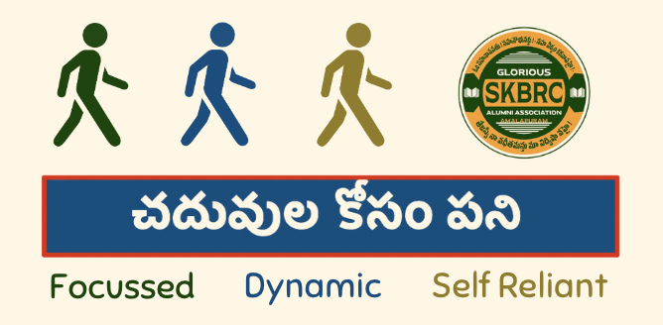
Training manual
An initiative by Glorious SKBRC alumni association

Slide 2
Introduction
GSAA thought the youth should not depend on their parents for higher education costs.
A student should be able to earn enough to support their education with fewer hours of work.
The scarcity of avenues supporting this motivated us to take an initiative to help our students.
In order to accomplish this goal, this training process will try to make the students focussed, dynamic and self-reliant.

Slide 3
Salesmanship
Skill to persuade someone to buy a product or service for a price .

Slide 4
Characteristics of a successful salesman
Presentable
Initiative
Dynamic nature
Communication skills
Empathetic

Slide 5
Know your product
Features
Life and utility
Operational convenience
Differential benefit to the competition
Cost to benefit ratio
Green products
  Solar roof
  Organic waste management products

Slide 6
Know your customer
Individuals
Institutions
Government agencies

Slide 7
Know your competitors
Solar roof
  As this is a subsidized program by the government, there is no direct competition
Organic waste management products
  As this is a unique nonthermal product, there is little to no competition.

Slide 8
Targets – Be SMART
S – Specific
M – Measurable
A – Attainable
R – Realistic
T – Time bound
REVIEW
REFIX

Slide 9
Sales process
Pre approach
Approach
Presentation
Handling objections
Closing techniques

Slide 10
Pre-approach
Enlisting the customers to optimise results based on geographical and potentiality parameters
Understand the customer needs
Timing the visit

Slide 11
Approach
Introduce yourself
Explain the concept of “Earn while you Learn”
Explain the importance of green products
Explain the background of the manufacturers
Excel Industries
Autm Solar Roofs

Slide 12
Presentation
Understand the customer requirements and recommend suitable products.
Explain the product features.
ROI

Slide 13
Handle objections
Cost
Payment terms
Performance proof
Servicing
Operational convenience

Slide 14
Closing techniques
Understanding the pulse of your customer
Induce competition amongst neighbours
Tailored suggestions
Impress economics of the product

Slide 15
Follow up
Customer seldom places an order in the first instance.
Follow up discretely.
Keep the customer informed about the buyers in their neighbourhood.

Slide 16
Conclusion
Benefits of a successful sales campaign
Self confidence
Teamwork
Understand the society

Slide 17

Let’s get going…

